Slide 1

Continuous Assessment - 1
Colonial Pipeline Ransomware Attack (May 2021)
Team Members:
1) Karnishwar R – 20086868
2) Anandha Krishnan S – 20055947
3) Sanu Mathew – 20075856
Module Title and Code - ORGANISATIONAL AND SOCIETAL CYBERSECURITY (B9CY106)
Module Instructor - Alexander Victor

Slide 2
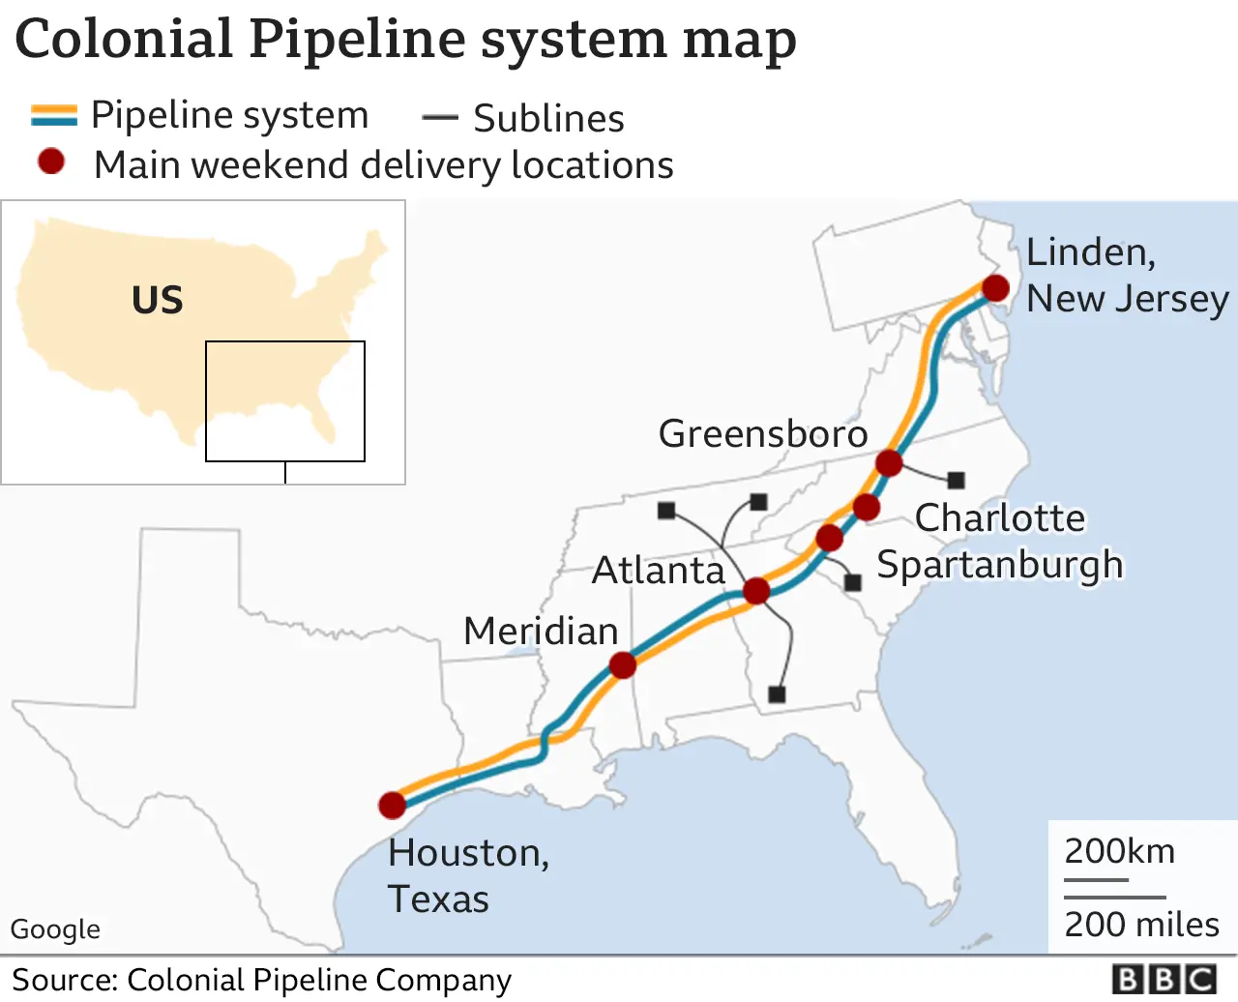
About Colonial Pipeline
Largest Fuel Pipeline Operator in US.
Supplies ~45% of East Coast Fuel.
Critical National Infrastructure.
Disruption affects millions.

Slide 3
Attack Overview
Ransomware attack (May 2021).
Carried out by DarkSide group.
VPN Credentials Compromised.
Hackers got details from the Dark Web.
Mostly due to data breaches, reused passwords.
IT systems were encrypted.
Operations were Shut Down.

Slide 4
Attack Timeline
Attack Dates | Explanation
April 29 | Hackers got the initial access to the details from Dark Web leaks.
May 6, 2021 | Eastern European Attackers from hacking group DarkSide stole approximately 100GB of company’s data.
May 7, 2021 | Ransomware was deployed across the company’s IT systems, data was encrypted and operations were disrupted.
May 7, 2021 | Operations were shut down by the organization after they detected the attack.
May 9, 2021 | Regional emergency was declared by U.S. government to help manage fuel supply disruptions caused by the outage.
May 12, 2021 | Operations were restored approximately after 5 days from shutdown.
June 7, 2021 | U.S. Department of Justice reported it had recovered most of the ransom payment in Bitcoin. (approx. 64 BTC out of 75 BTC) nearly $2.3 million

Slide 5
Technical Attack Chain
Initial access.
Reconnaissance.
Lateral Movement.
Data Exfiltration.
Encryption.
Ransom.

Slide 6
MITRE ATT&CK X COLONIAL PIPELINE
Phase | Technique Used | Explanation
Initial Access | Valid Accounts (T1078) | Attackers logged in using stolen VPN credentials.
Persistence | Remote Services (T1021) | VPN access allowed continued remote entry into network.
Discovery | Network Discovery (T1046) | Attackers exploited internal systems to identify servers and weak points.
Lateral Movement | Remote Services (T1021) | Movement between multiple systems sue to weak network segmentation.
Exfiltration | Data Staging (T1074) | Approximately 100GB of data was exported.
Impact | Data Encryption For Impact (T1486) | Ransomware encrypted files and disrupted business operations.

Slide 7
Organizational Failures
No Multi Factor Authentication.
Weak and reused passwords.
Poor monitoring.
No Network segmentation.
Reactive Response.

Slide 8
Societal Impact
5-day shutdown.
Fuel shortages.
Panic buying.
Long queues.
Fuel price increases.
Logistics and Aviation operational disruptions.

Slide 9
Financial Impact
Ransom paid in Bitcoin.
Organization paid 75 BTC ≈ $4.4 million.
~64 BTC recovered.
≈ $2.3 million seized.
Recovered by U.S. Department of Justice & Federal Bureau of Investigation.
Total losses like operation resurrection and others exceeded the ransom cost.

Slide 10
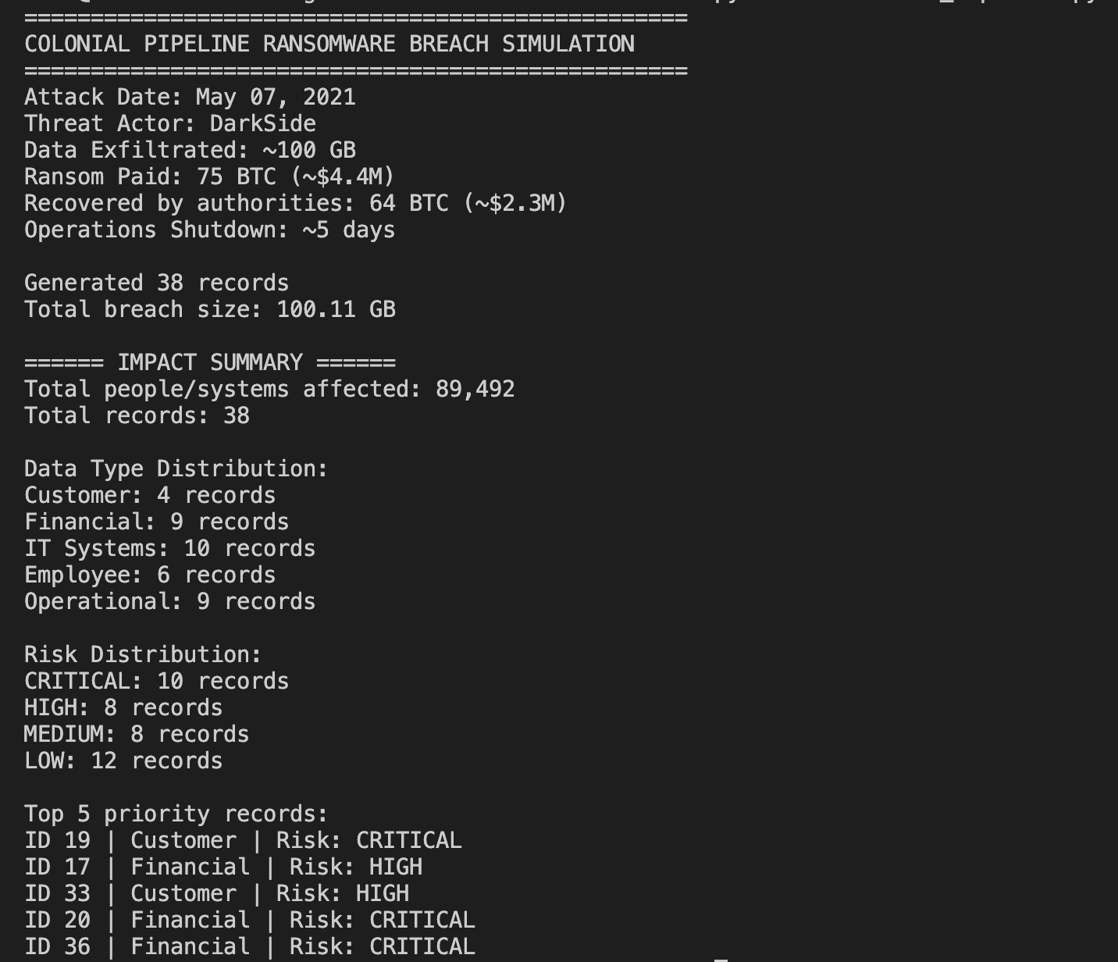
Simulation Approach
We built a python breach simulator.
Simulates a 100GB data breach scenario.
Creates fake breach reports.
Classifies risks.
Estimates affected systems.

Slide 11
Conclusion
Enforce MFA for all remote access.
01
Implement strong password and access policies.
02
Implement network segmentation and monitoring.
03
Develop faster detection and incident response plans.
04
Use simulations and testing to improve preparedness.
05

Slide 12
References
1) What is the Colonial Pipeline Hack? A Timeline of Events by Eye on Tech - Link (YouTube Video)
2) How a cyber-attack crippled the Colonial Pipeline by CNET - link (YouTube Video)
3) The Attack on Colonial Pipeline: What We’ve Learned & What We’ve Done Over the Past Two Years by America's Cyber Defence Agency (CISA – CYBERSECURITY & INFRASTRUCTURE SECURITY AGENCY) - Link
4) Cyber Case Study: Colonial Pipeline Ransomware Attack by CoverLink Insurance - Ohio Insurance Agency - Link
5) Department of Justice Seizes $2.3 Million in Cryptocurrency Paid to the Ransomware Extortionists Darkside by U.S. DEPARTMENT OF JUSTICE - Link
Thank You.

